Slide 1


Slide 2



Welcome back!
While we’re waiting to start, please:
How was your homework?
How confident are you in your financial projections?

Slide 3
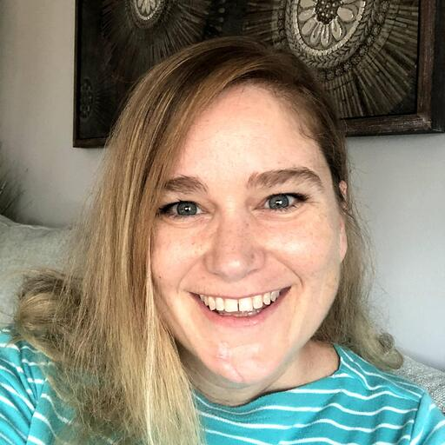

Welcome back! 👋
Karen Licurse
Digital Boost
Masuma Moledina
Digital Boost

Slide 4
Looking back at last week… 🚀
Week 1
Week 2
Week 3
Week 4
Week 5
Week 6
Are you ready?
Immerse yourself
Create your plan
Let’s talk about money
Take it to the world
Making it happen
Getting into the right mindset to start your entrepreneurial journey
Diving in to research your idea and focus in on who your customers will be
Taking the first steps towards writing your business plan
Figure out how much money you'll need and how you'll fund it
Bring your idea to reality. Build your products, brand and digital presence
Drive sales and stay on track whilst looking after yourself
Focus:
The idea
Focus:
Market research
Focus:
Business plans
Focus:
Funding & finance
Focus:
Marketing & brand
Focus:
Launch!

Slide 5
Key messages
Get your financial foundations in place from the beginning
Ask for help - but own this!
Get granular about how you’ll make money, how much it’ll cost & the breakeven point
When thinking about revenue streams & pricing, focus on the customer - and test!
Know your numbers - P&L and cash flow
In forecasting, you’ll need to make lots of assumptions - educated guesses!
Establish a healthy financial routine - book-keeping, reporting etc.
The right funding approach will depend on your desired speed, scale and
risk tolerance
You’ll need to creative - bootstrapping!

Slide 6
This week’s focus: branding and marketing
Week 1
Week 2
Week 3
Week 4
Week 5
Week 6
Are you ready?
Immerse yourself
Create your plan
Let’s talk about money
Take it to the world
Making it happen
Getting into the right mindset to start your entrepreneurial journey
Diving in to research your idea and focus in on who your customers will be
Taking the first steps towards writing your business plan
Figure out how much money you'll need and how you'll fund it
Bring your idea to reality. Build your products, brand and digital presence
Drive sales and stay on track whilst looking after yourself
Focus:
The idea
Focus:
Market research
Focus:
Business plans
Focus:
Funding & finance
Focus:
Marketing & brand
Focus:
Launch!

Slide 7
Your turn
What does branding mean to you?

Slide 8

What is branding?
NOT JUST:
Logo
Colours
Tagline
Branding is what people think, feel and say about your business.

Slide 9
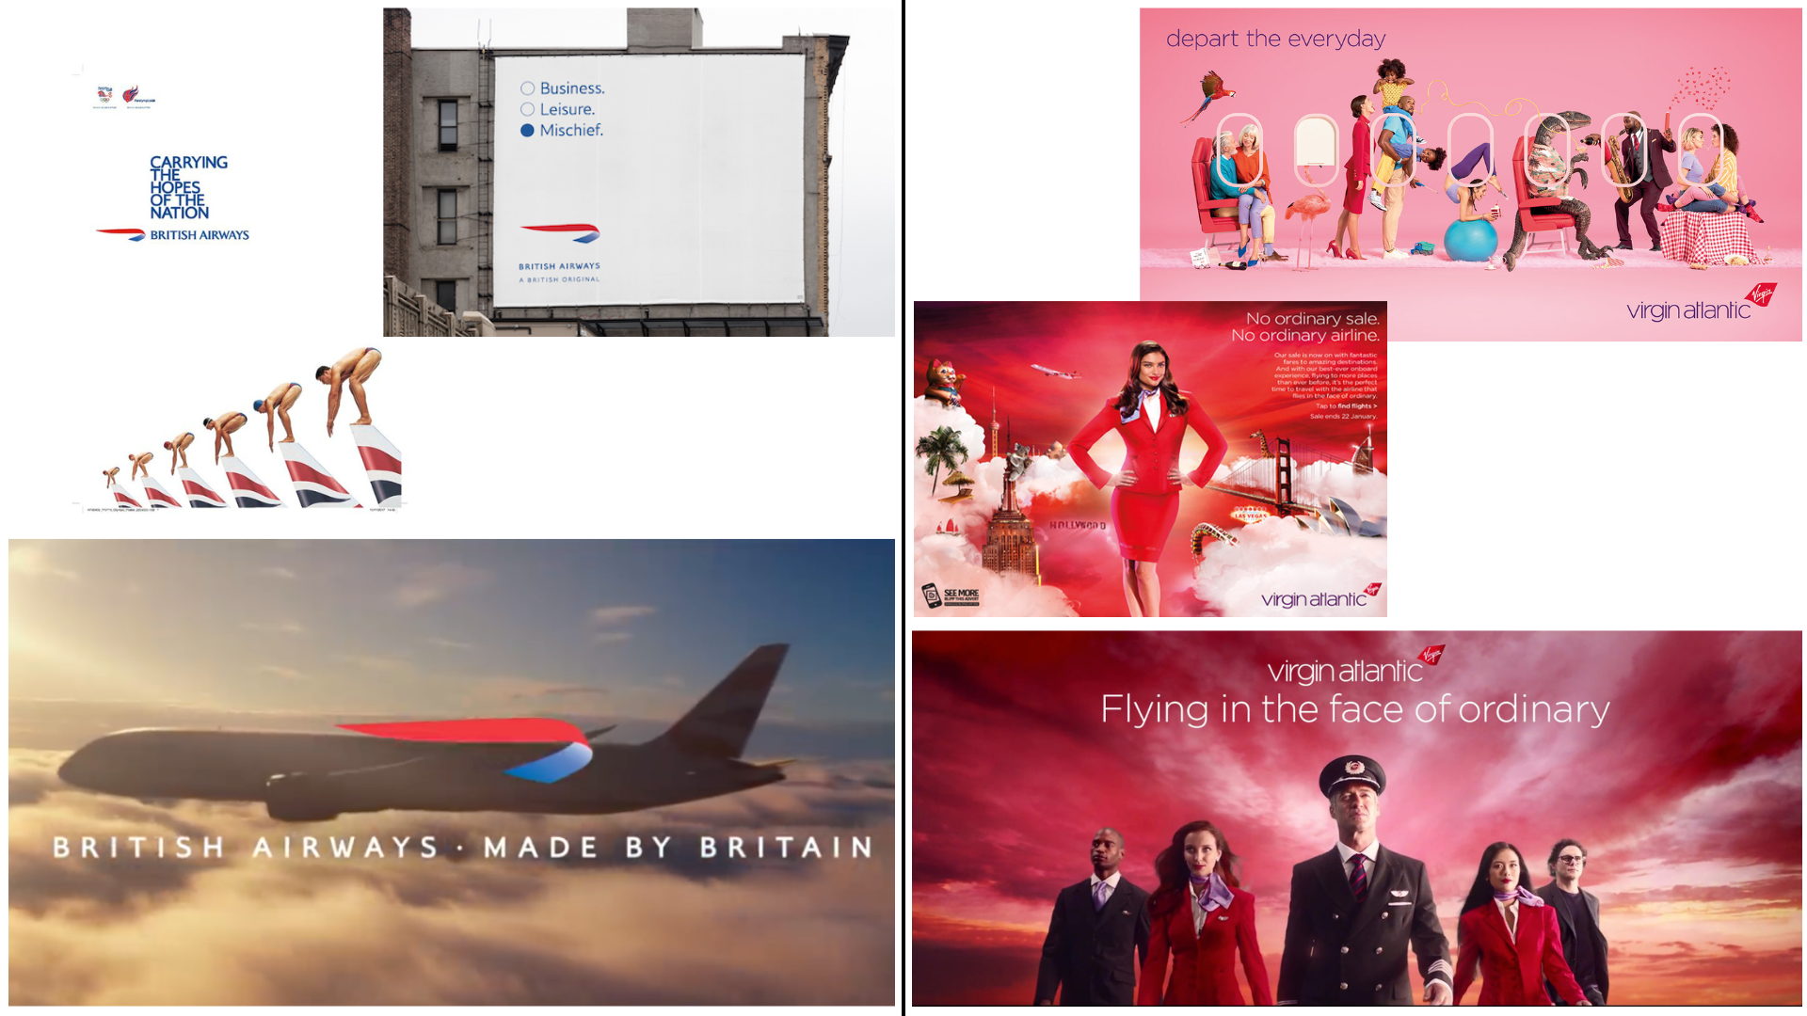
How do you want your brand to make people feel?

Slide 10
Brand encompasses everything a customer or stakeholder sees, touches & feels
BRAND APPLICATION & CAMPAIGNS
Website
Videos
Emails
Ads
Mobile
Blog
Packaging
Recruiting
VISUAL IDENTITY & PERSONALITY
Logo
Colours
Images
Icons
Fonts
Voice
Shapes
Sounds
Vestibulum congue
PURPOSE, POSITIONING, STORY

Slide 11


Slide 12
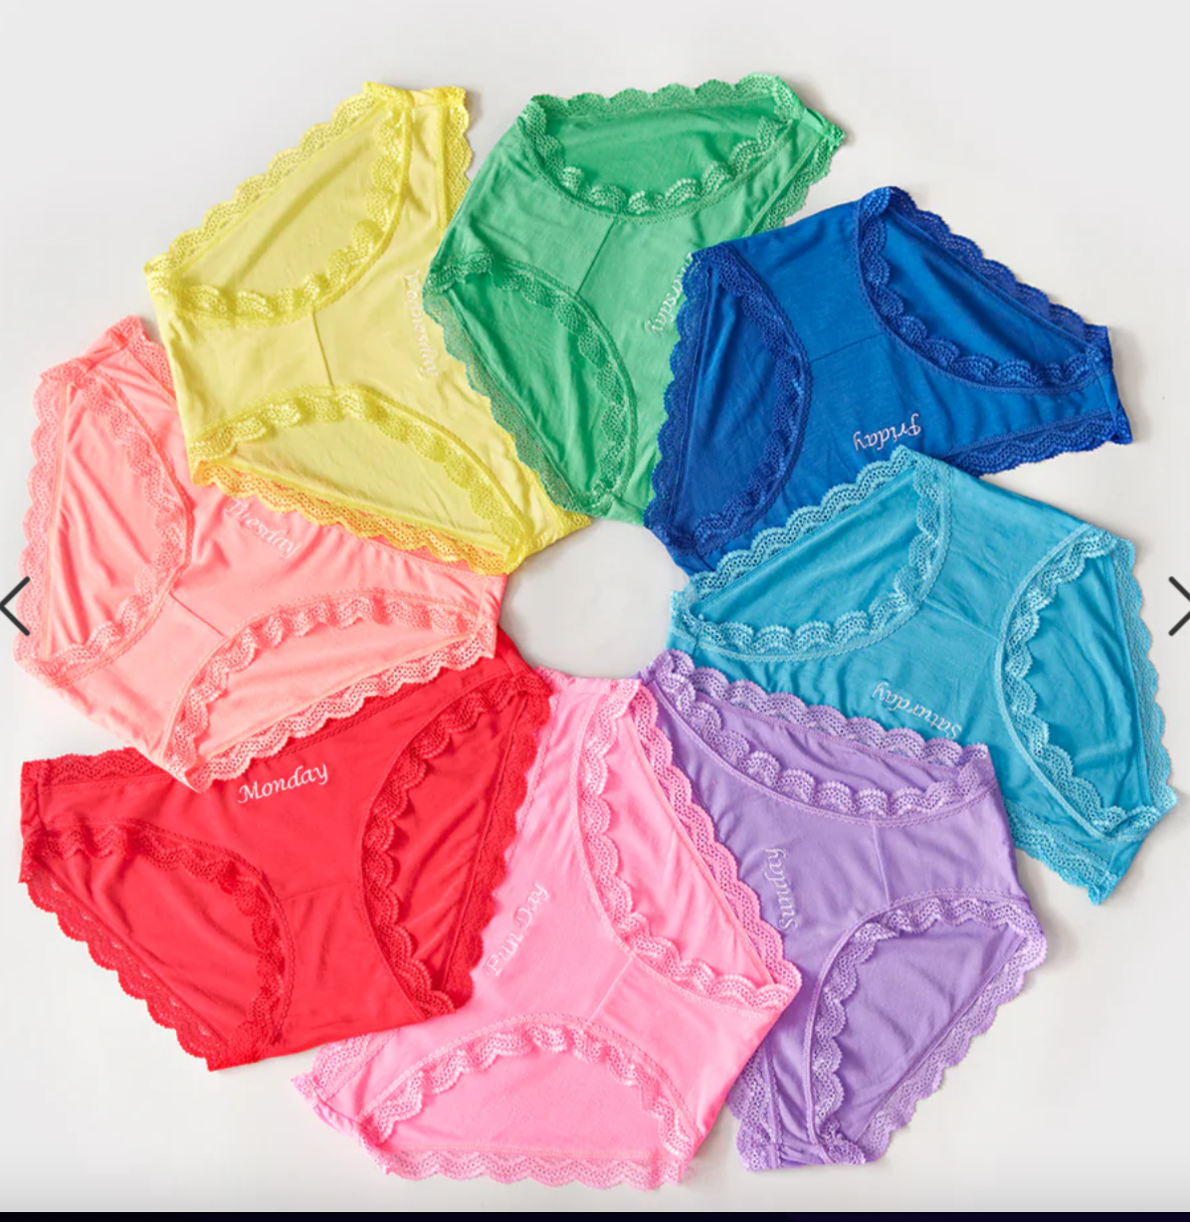

Notes:
We’ll be filling this in together throughout the session & will go through each section one by one - don’t go through it all on this slide. Ask people to fill this in as we go through the slides.

Slide 13


Slide 14


Slide 15

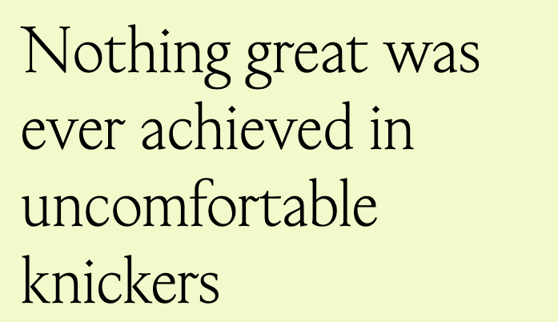

Slide 16
Stripe & Stare
The world’s comfiest and most sustainable underwear
Our target customer chooses us because…
5-star comfort
Perfect for every day - but not frumpy
Playful
Sustainable
Female founded
We make them feel…
Empowered, supported, fun and comfy

Slide 17
Customer-focused
Benefit-led
Focus!
Keep it simple
Future-focused

Slide 18
It all starts with your story…
Who you are
Why you do what you do
What makes you different
Make people want to be part of it!

Slide 19


Slide 20
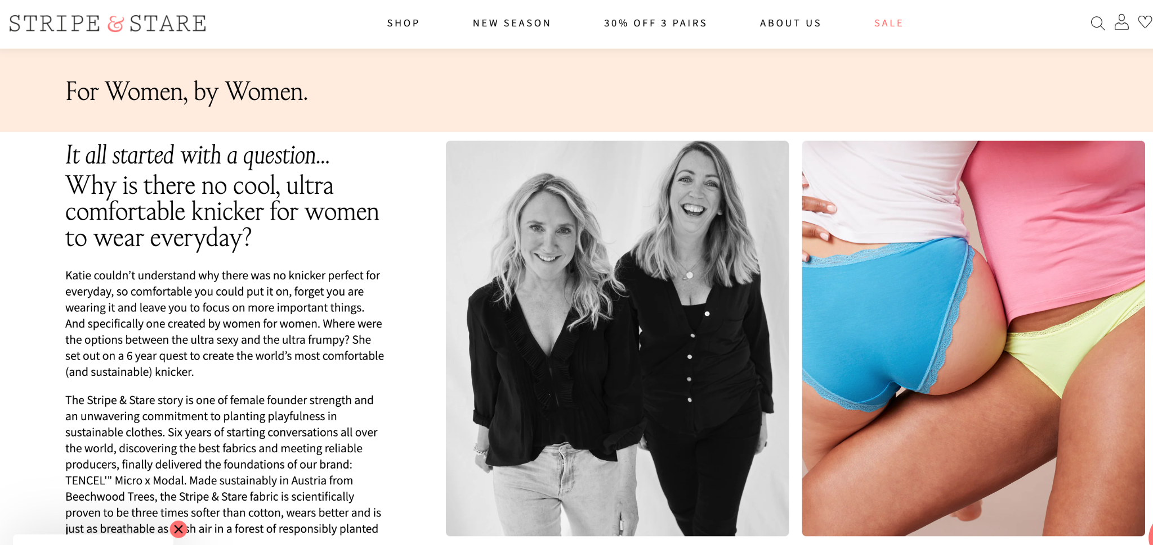

Slide 21
Then translate your story and ‘feeling’ into a tone of voice & visual concepts
calm
DIRECT
budget
Established
Visual identity: Fonts, colours, shapes, images, shapes, icons, sounds

Slide 22

Kate Prince - Ancient & Brave
“Visualise the brand.”

Slide 23

Individual reflection
Think about how you want people to think, feel or say when they interact with your brand.
What 3 words do you want to come to mind?

Slide 24

Breakout discussion
Share the brand mood board you created without
explaining why you chose the items on it.
As you’re looking at each other’s moodboards,
what three words come to mind?

Slide 25

How succinctly and clearly can you define these?
Our target customer chooses us because…
Proven to be suitable for eczema prone and sensitive skin
Natural / sustainable
Family focused
Colourful
We make them feel…
Trusting, relieved, understood

Slide 26
What’s in a name?
Is it easy to say?
Does it have bad or other connotations that could confuse?
Is too long?
Is anyone else using it? https://find-and-update.company-information.service.gov.uk
https://www.namecheckr.com

Slide 27
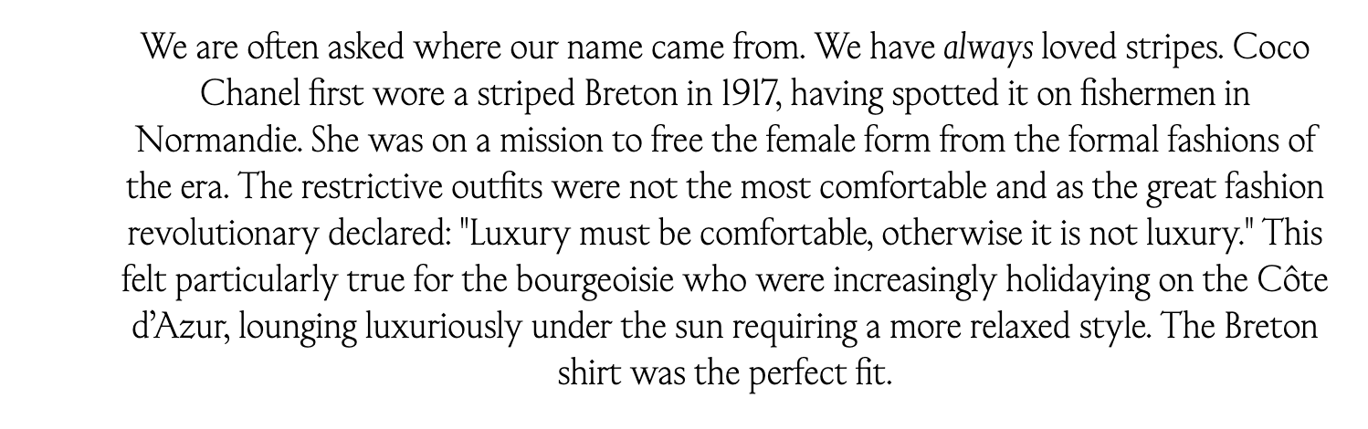

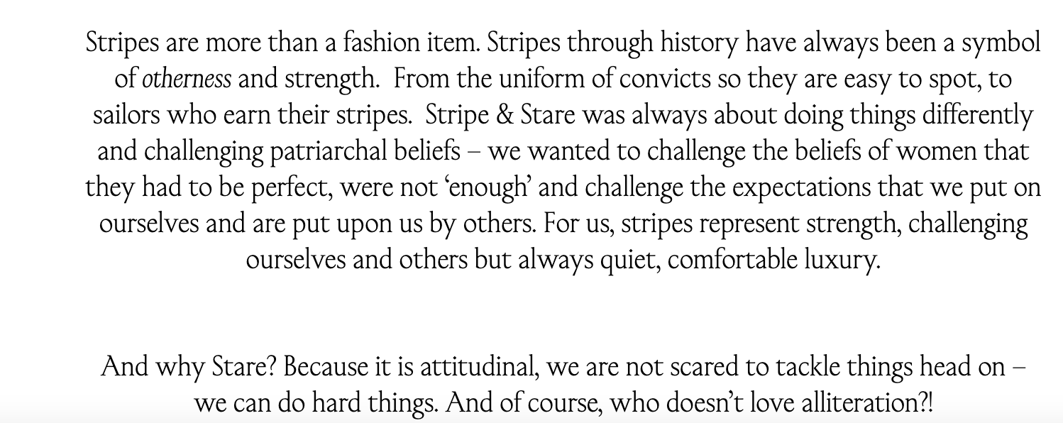

Slide 28
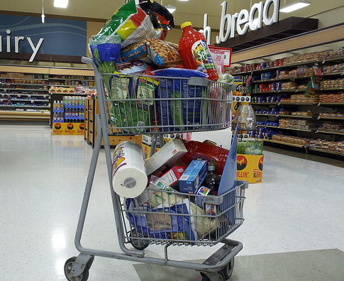
Your marketing plan

Slide 29
Roadmap
Focus
Time / money
Accountability
Measurement

Slide 30
Key elements of a marketing plan
WHAT
OBJECTIVE
WHO
TARGET CUSTOMER
HOW
STRATEGY
WHERE
CHANNELS / TACTICS
WHEN
METRICS / TIMING

Slide 31
Key elements of a marketing plan
WHAT
OBJECTIVE
WHO
TARGET CUSTOMER
HOW
STRATEGY
WHERE
CHANNELS / TACTICS
WHEN
METRICS / TIMING

Slide 32
Start with clarity on your key objectives
- from the target customer perspective
AWARENESS / EDUCATION | Make people aware that your ‘category’ exists and may be something they need
 | Help people who are actively seeking out your ‘category’ to know your brand exists
CONSIDERATION | Help people who may have heard of you think about buying from you
CONVERSION | Get people who already know you to buy
FREQUENCY / GROWTH | Get existing customers to buy more or more often
REACTIVATION | Get previous customers who stopped buying to buy again
ADVOCACY | Grow existing customers and get them to talk about you

Slide 33
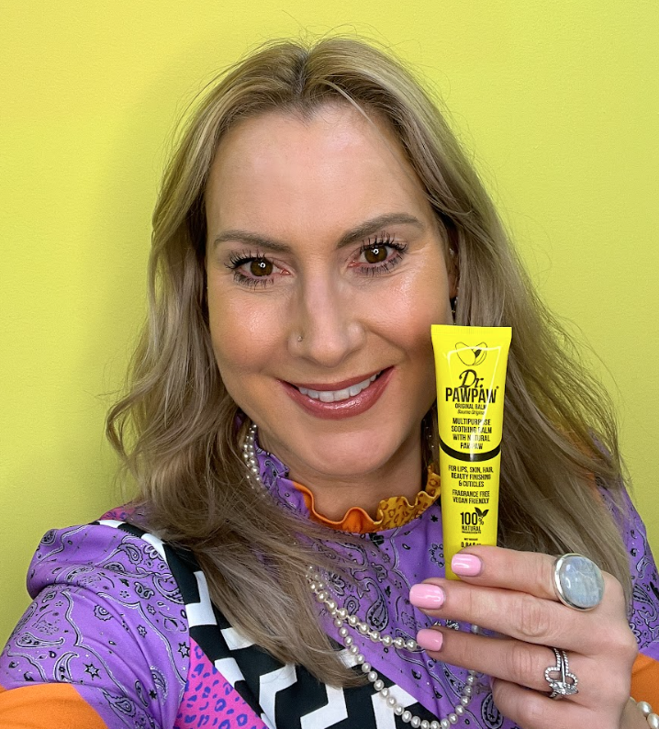
What shift do you need in the how the customer thinks, feels or behaves?
FROM
What is PAWPAW fruit?
TO
PAWPAW fruit is an incredible elixir for so many ailments

Slide 34

What shift do you need in the how the customer thinks, feels or behaves?
FROM
I use my serum 1x a week
TO
My serum is an essential part of my daily routine

Slide 35
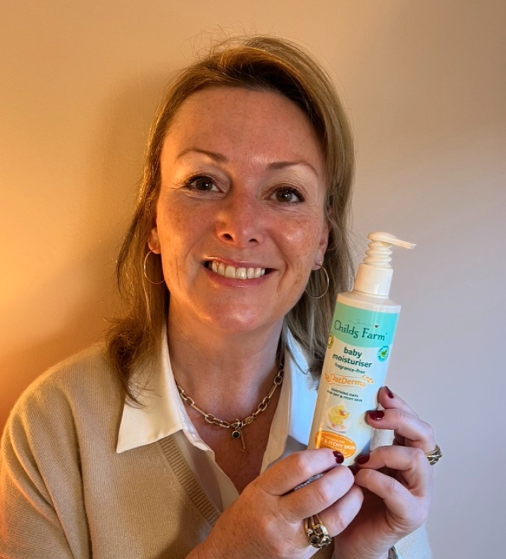
What shift do you need in the how the customer thinks, feels or behaves?
FROM
I’m so confused - I don’t know who or what to trust for my baby with eczema - what is safe and effective?
TO
I have complete trust that this solution is natural and proven for eczema prone skin

Slide 36
Individual reflection
What is the biggest objective
you have for your marketing?

Slide 37
Key elements of a marketing plan
WHAT
OBJECTIVE
WHO
TARGET CUSTOMER
HOW
STRATEGY
WHERE
CHANNELS / TACTICS
WHEN
METRICS / TIMING

Slide 38


What does your target customer’s day look like?
What do they read, watch, see, do?
Whose opinion do they trust? Be specific!

Slide 39
SARAH
Educated, busy professional working mum of 2, living in the outskirts of a city
WANTS
SAYS
FEELS
All these options look the same - how do I know which is right? I’m wasting a lot of money on stuff that’s not working.
How do I know what to trust?
Motherhood is hard - I feel alone - who can help me?
A solution for her child’s eczema
I’ll try anything to relieve her pain. I want something effective.
FEARS
DOES
SEES / HEARS
Harsh chemicals are bad for my child and could have long-term effects.
I’m a bad mother because I can’t solve this problem for her.
Works long hours so does one big shop at Tesco on Saturday mornings or buys from smaller retailers online.
Does her best to have a healthy diet for her family but convenience is also important. Goes to yoga 3x a week.
Reads labels but doesn’t really understand them all, so gets confused.
Talks to other mums at the school gates or her childrens’ games.
Turns to local Facebook mum groups for advice and recommendations
Googles advice online and reads reviews on Amazon
Values the advice of health influencers

Slide 40
Key elements of a marketing plan
WHAT
OBJECTIVE
WHO
TARGET CUSTOMER
HOW
STRATEGY
WHERE
CHANNELS / TACTICS
WHEN
METRICS / TIMING

Slide 41
Define your strategy before jumping into specific channels or content
Build trust through testing and packaging claim
Build word-of-mouth and trust by encouraging other mums to share and talk about their experiences
Build a fan base before going to retail

Slide 42
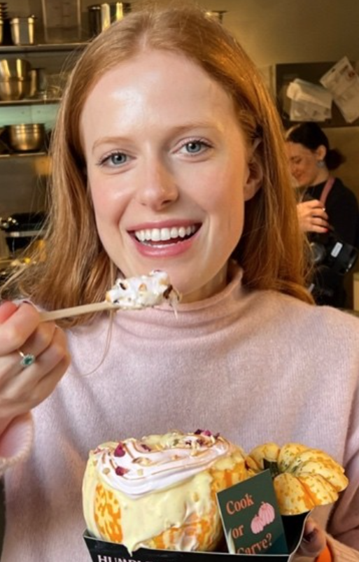
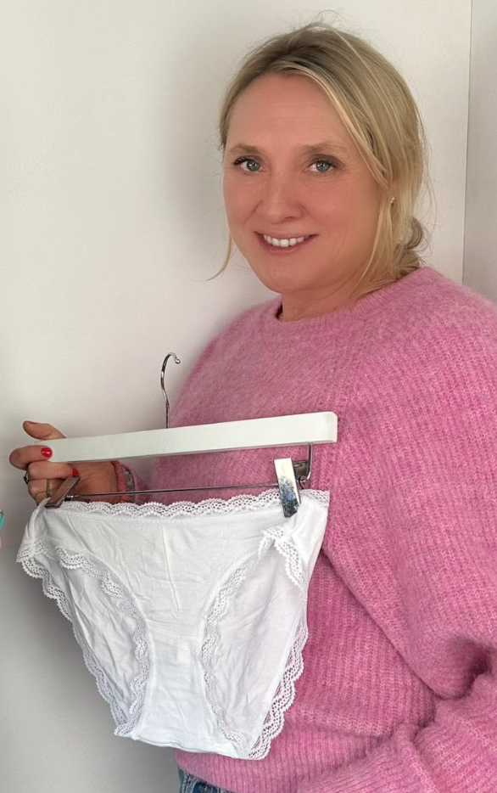
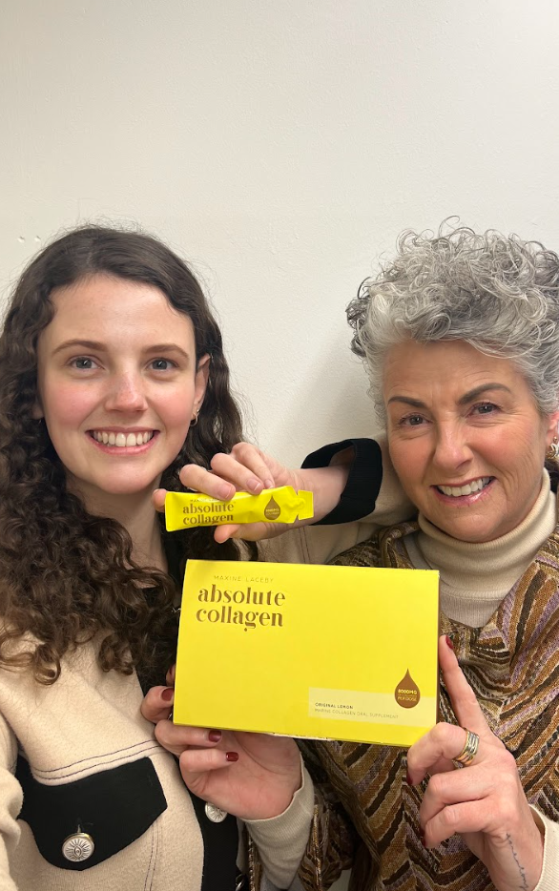
Example marketing strategies
Build a natively social experience to drive virality
Connect with cultural moments and trends
Build community

Slide 43
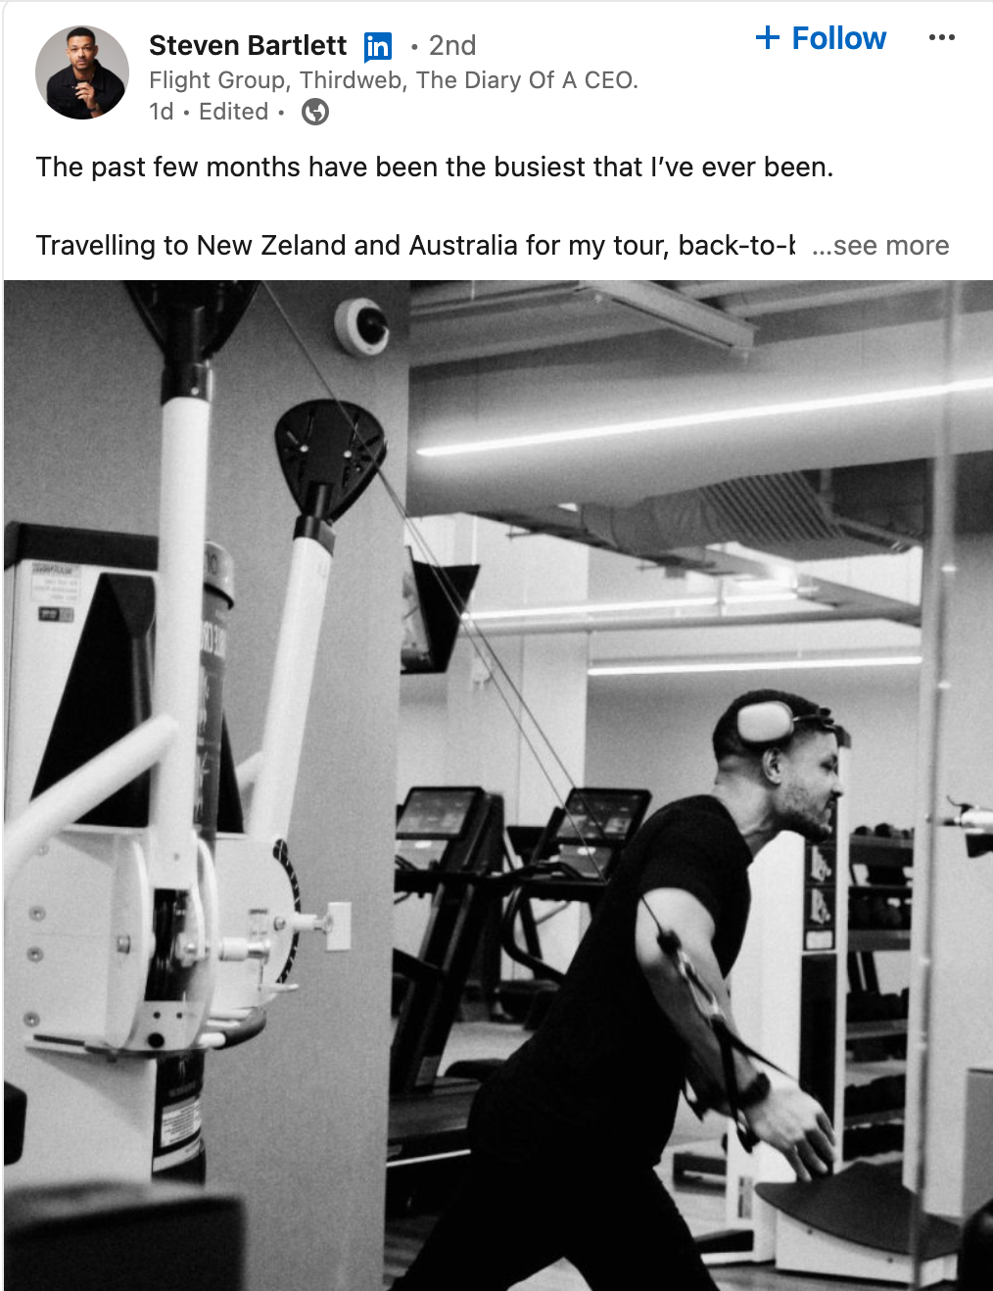
The power of personal branding

Slide 44
Key elements of a marketing plan
WHAT
OBJECTIVE
WHO
TARGET CUSTOMER
HOW
STRATEGY
WHERE
CHANNELS / TACTICS
WHEN
METRICS / TIMING

Slide 45
EXAMPLE TACTICS
AWARENESS | CONSIDERATION | CONVERSION | FREQUENCY / GROWTH | REACTIVATE | ADVOCACY
Advertising Search engine advertising Search engine optimisation Influencers Events Word of mouth | Social Media Blogs Educational content Email marketing Website Reviews/Case studies Newsletter Product Demos Samples User generated content | Website experience Pricing / Promotions Payment options | Service Email marketing In store New products Bundles | Email marketing Dedicated outreach Promotions | Community Advocate Campaigns Refer a friend

Slide 46

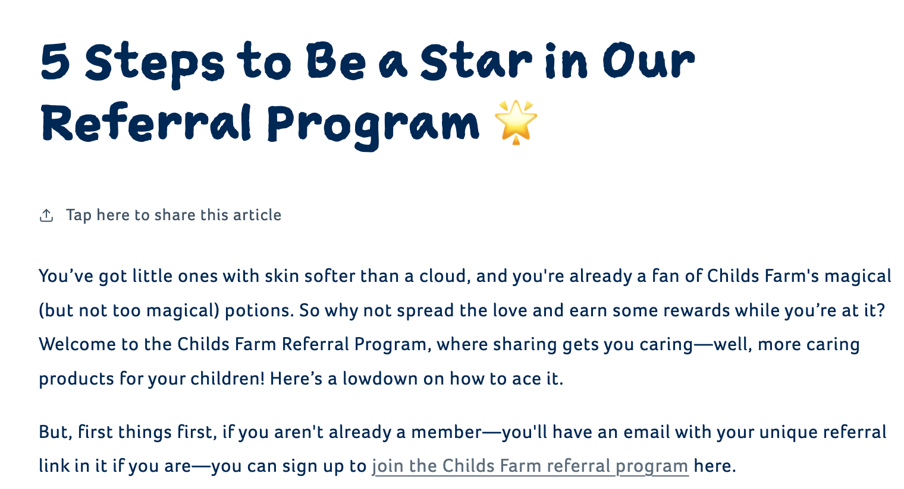
Tactics - Build trust
Packaging claim
Ambassador programme
School gate sampling
Facebook groups / ads

Slide 47

You can not do everything - focus on 1-2 tactics to do well

Slide 48
Key elements of a marketing plan
WHAT
OBJECTIVE
WHO
TARGET CUSTOMER
HOW
STRATEGY
WHERE
CHANNELS / TACTICS
WHEN
METRICS / TIMING

Slide 49
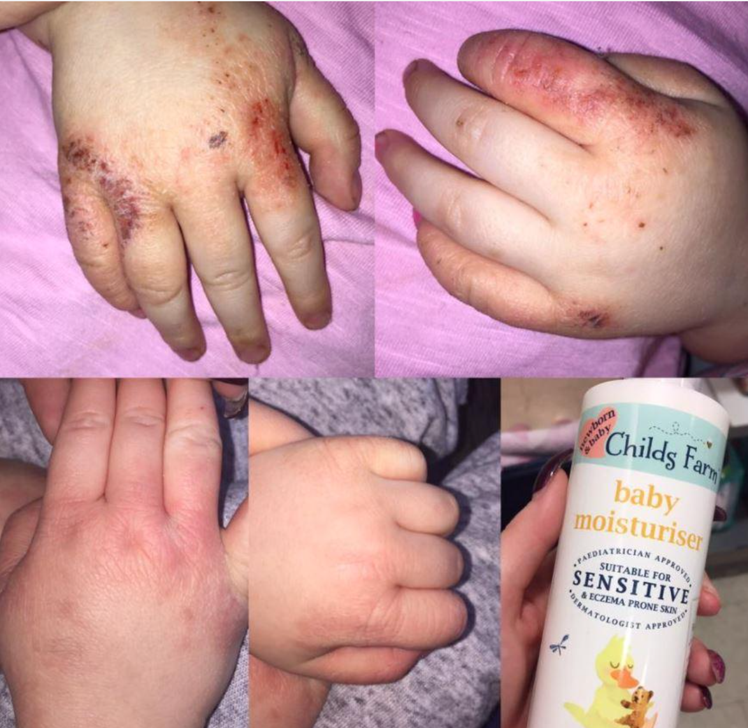
Impact

Slide 50
Key elements of a marketing plan
WHAT
OBJECTIVE
WHO
TARGET CUSTOMER
HOW
STRATEGY
WHERE
CHANNELS / TACTICS
WHEN
METRICS / TIMING

Slide 51
Breakout discussion
Share your initial thoughts on your marketing strategy - what will you do and why?
How will you measure success?

Slide 52
Your brand foundations - get basics in place
Website
Social Presence
Google Business Profile

Slide 53
Next week’s focus: making it happen
Week 1
Week 2
Week 3
Week 4
Week 5
Week 6
Are you ready?
Immerse yourself
Create your plan
Let’s talk about money
Take it to the world
Making it happen
Getting into the right mindset to start your entrepreneurial journey
Diving in to research your idea and focus in on who your customers will be
Taking the first steps towards writing your business plan
Figure out how much money you'll need and how you'll fund it
Bring your idea to reality. Build your products, brand and digital presence
Drive sales and stay on track whilst looking after yourself
Focus:
The idea
Focus:
Market research
Focus:
Business plans
Focus:
Funding & finance
Focus:
Marketing & brand
Focus:
Launch!

Slide 54
Your homework
Watch the bonus videos on how the founders grew their following
Build out your draft marketing plan
Then watch the next round of videos on how our founders got their first customers
Reflect on the specific actions you’ll need to take to generate your first (or next) sale - capture and prioritise.

Slide 55
Action plan to drive traction
30
60
90

Slide 56

Have a great week!

