Slide 1
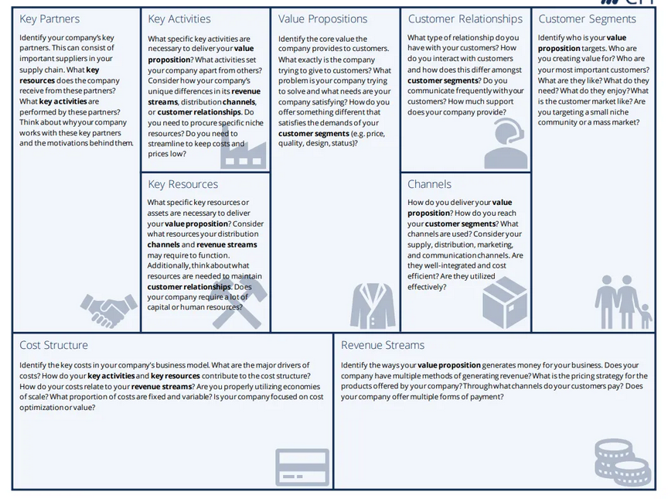

Slide 3
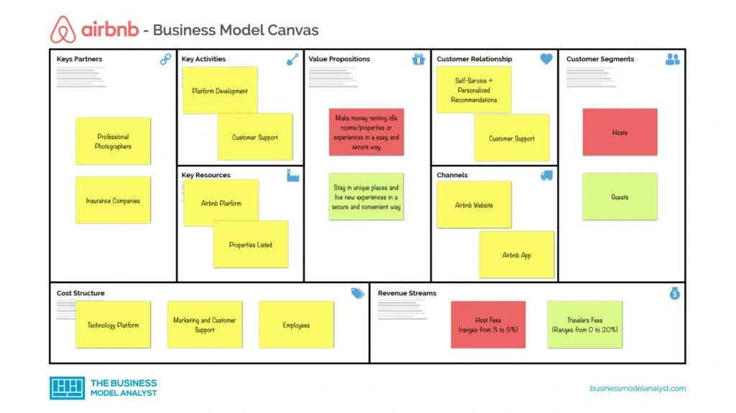

Slide 4
Year 1
Key partners
Key activities
Value propositions
Customer relationships
Customer segments
Key resources
Channels
Cost structure
Revenue Streams

Slide 5
Year 3
Key partners
Key activities
Value propositions
Customer relationships
Customer segments
Key resources
Channels
Cost structure
Revenue Streams

Slide 6
Year 5
Key partners
Key activities
Value propositions
Customer relationships
Customer segments
Key resources
Channels
Cost structure
Revenue Streams

